Slide 1

Architecting MLOps in the Cloud: Practice
Indika Kumara
Fabiano Pecorelli
Gemma Catolino
Rick Kazman
Damian Andrew Tamburri
Willem-Jan van den Heuvel

Slide 2
Content
The content is based on the courses I teach in the master’s program at JADS.
Data Engineering
Advanced Data Architecture
We will only use a small subset.

Slide 3
Data Engineering: Lectures, Labs and Assignments
GCP, VM, and Linux
Lab 1
VMs and Containers
Docker (Model as Service)
Labs 2
Assignment 1
Lectures 2-3
Lab 6: Assignment 1 Issues
MLOps Pipelines
Cloud Build (CI/CD)
Labs 3
DevOps and MLOps
GCP Vertex AI
Labs 4-5
Lectures 4-5
Docker Compose
Data Architecture
Data Pipelines
GCP DataProc (Spark)
Assignment 2
Labs 7-10
Batch Pipeline
Lab 11: Assignment 1 Issues
Stream Pipeline
Kafka, BigQuery, and Looker
Lectures 6-10

Slide 4
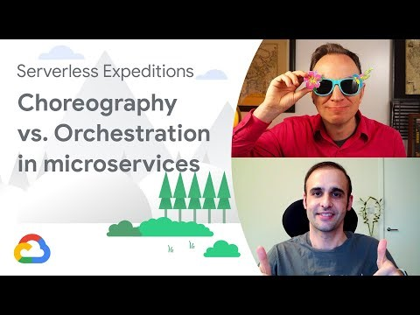
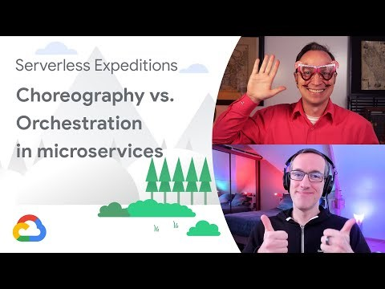
Advanced Data Architecture: Labs Plan
RESTFul Services with Python
Orchestration
Google Workflow
Data Mesh Design
Microservice Architecture Design
Open API
API Gateway
RESTFul Services/APIs
Kubernetes
Choreography
Applying DDD
(Domain-Driven Design) and Design Patterns
Docker
Event Bus / MOM
CI-CD
Microservice Integration and Composition
FaaS
FaaS with Google Cloud Functions
Classical Data Architecture
Extending Data Warehouse Architecture with Metrics Layer
Microservice Development and Deployment
To get an Idea of what we will do!
dbt (data build tool)
Airflow Pipelines
Notes:
dbt is a data transformation tool that enables data analysts and engineers to transform, test and document data in the cloud data warehouse

Slide 5
Let’s consider what we do today ………..

Slide 6
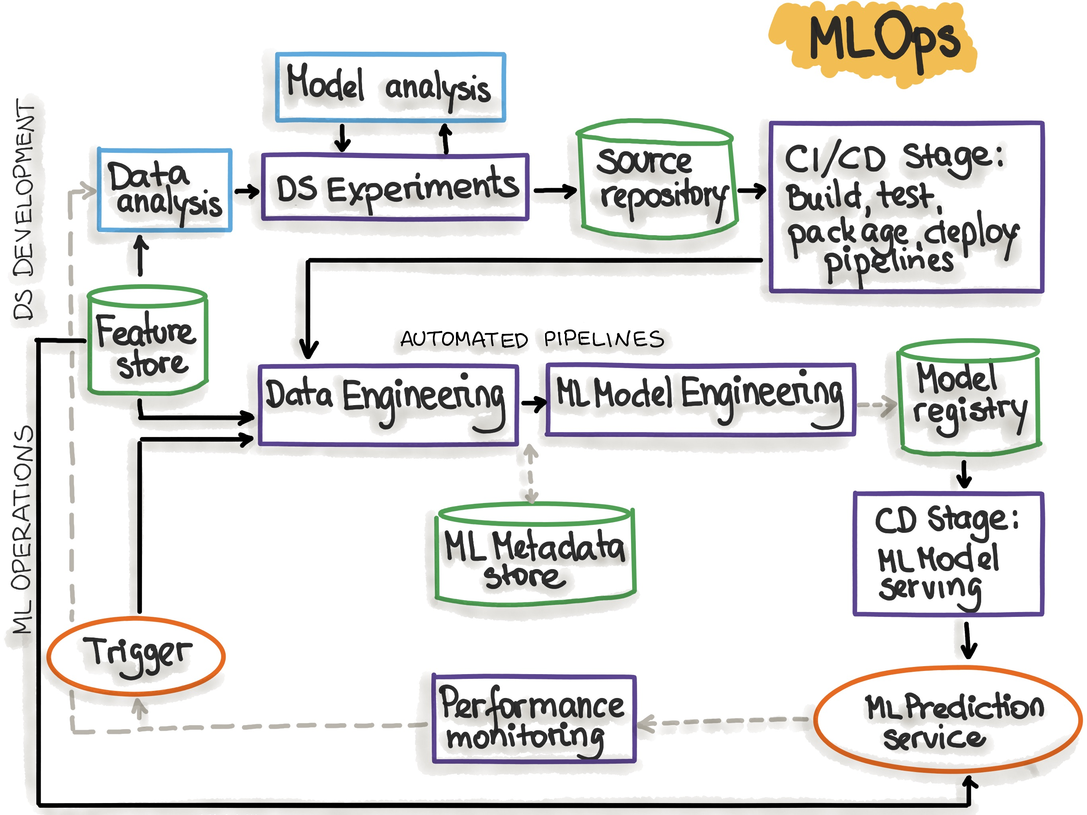
Overview
Implementing MLOps in the GCP (Google Cloud Platform)
DS Experiments
Vertex AI notebooks and Pipelines
CI-CD
Google Cloud Build
Event-Driven Triggers
Cloud Functions and Cloud Events
Model Hosting Environment
Cloud Run

Slide 7

Use Case
Binary Classification
Original source code is from https://machinelearningmastery.com/save-load-keras-deep-learning-models/
Predict if a user has diabetes or not.
I refactored the source code to make it a distributed ML application with the separate components for model training, prediction, and UI.
Training Pipeline
model.h5/pkl
Prediction UI
Prediction
API
Training API

Slide 8
Getting Google Cloud Credits
Google provides free 300 USD credits.
You need to provide a credit card – but Google will not charge you.
Also, this tutorial needs less than 10 USD credits (mostly even less than 5 USD).
Please follow https://www.youtube.com/watch?v=ogzJovMsDIU
(How to use the Google Cloud Free Program)
To do all labs and assignments in my course, a student only needs around 40 USD.

Slide 9
Source Code Repository for Tutorial
https://github.com/IndikaKuma/MLOpsGCP
Include Tutorial slides too
Make a fork of this repository

Slide 10
Part 1: Experimentation and ML Pipeline Development with Vertex AI

Slide 11
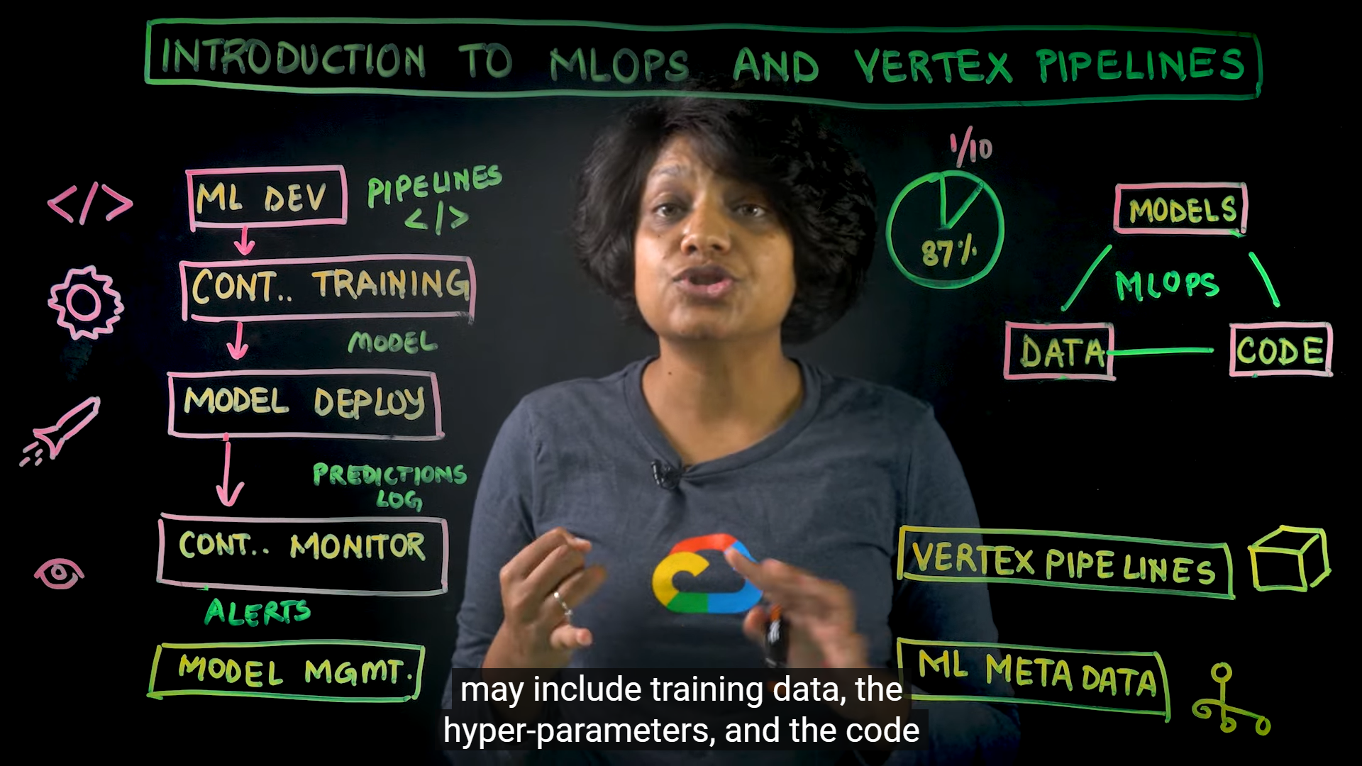
Vertex AI
Serverless MLOps Platform from Google
Introduction to MLOps and Vertex Pipelines
https://www.youtube.com/watch?v=Jrh-QLrVCvM
The key to MLOps is the ability to define ML pipelines and data pipelines as executable declarative specifications (workflows) that can be treated and managed as programing source code.

Slide 12
Building Vertex AI Pipelines
Vertex AI Pipelines can run pipelines built using the Kubeflow Pipelines SDK or TensorFlow Extended.
We will use Kubeflow Pipelines SDK (software development kit).
With Kubeflow, we can use Python code to create the pipeline.
A pipeline is a description of an ML workflow, including all of the components in the workflow and how they combine in the form of a graph.
A pipeline component is a self-contained set of user code, packaged as a Docker image, that performs one step in the pipeline.
Component has an implementation (e.g., python function) and interface/specification (YAML file describing inputs, outputs, container image, etc.)
See the components provided by Google https://cloud.google.com/vertex-ai/docs/pipelines/gcpc-list
We can create custom components.
Notes:
Which pipelines SDK should I use?
Vertex AI Pipelines can run pipelines built using the Kubeflow Pipelines SDK v1.8.9 or higher, or TensorFlow Extended v0.30.0 or higher.
If you use TensorFlow in an ML workflow that processes terabytes of structured data or text data, we recommend that you build your pipeline using TFX.
To learn more about building a TFX pipeline, follow the TFX getting started tutorials.
To learn more about using Vertex AI Pipelines to run a TFX pipeline, follow the TFX on Google Cloud tutorials.
For other use cases, we recommend that you build your pipeline using the Kubeflow Pipelines SDK. By building a pipeline with the Kubeflow Pipelines SDK, you can implement your workflow by building custom components or reusing prebuilt components, such as the Google Cloud Pipeline Components. Google Cloud Pipeline Components make it easier to use Vertex AI services like AutoML in your pipeline.
This guide describes how to build pipelines using the Kubeflow Pipelines SDK.
The Kubeflow project is dedicated to making deployments of machine learning (ML) workflows on Kubernetes simple, portable and scalable.

Slide 13
Building Vertex AI Pipelines (Cont’d)
There are two ways to create the pipeline components:
Use in-line Python Functions https://www.kubeflow.org/docs/components/pipelines/v1/sdk-v2/python-function-components/
Explicitly define component specifications and containerize the component’s code https://www.kubeflow.org/docs/components/pipelines/v1/sdk-v2/component-development/
We will use the first option today.

Slide 14
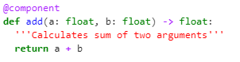
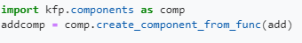
Writing Python function-based Components
add is the python function.
@component decorator or create_component_from_func can be used to create a Kubeflow component from a standard python function.
Each function is executed in a separate container. So, the functions cannot call each other directly.
Source: https://www.kubeflow.org/docs/components/pipelines/v1/sdk-v2/python-function-components

Slide 15
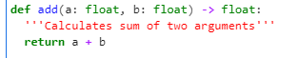
Writing Python function-based Components (Cont’d)
Python function should be self-contained.
It should not use any code declared outside of the function definition.
Import statements must be added inside the function.
Helper functions must be defined inside this function.
The data types of Inputs and outputs of a function should be explicitly declared.
There are specific decorators (annotations) to be used.
typing.NamedTuple when returning multiple outputs
kfp.v2.dsl.Dataset, Metrics, Model, etc., when returning large data sets as files
See float
Basic types are int, double, float, or str

Slide 16
Writing Python function-based Components (Cont’d)
When creating a component from a function (via @compoent annotation or create_component_from_func), we can provide the following configurations:
base_image: Specify the Docker container image to run this function in.
output_component_file: Writes the component definition to a file. We can use this file to share the component with others or reuse it in different pipelines.
We will consider component definitions next week.
packages_to_install: A list of versioned Python packages to install before running your function.
If the function has complex dependencies, choose or build a container image for the Python function to run in.

Slide 17
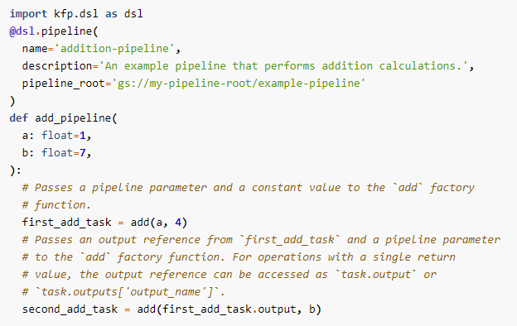
Defining Pipelines
We can use a python function to define the pipeline.
The example is a pipeline with two steps (of add component).
add-pipeline is the pipeline definition function
a and b are parameters.
@dsl.pipeline is the decorator or annotation to say this is a Kubeflow pipeline definition.

Slide 18
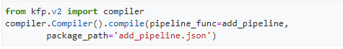
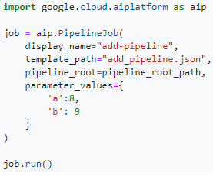
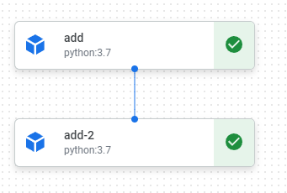
Compiling and Executing Pipelines
We use Vertex AI to compile and run pipelines.
First, compile to create the specification of the executable pipeline (in JSON)
Now, we can execute the pipeline by simply using the generated json based pipeline specification.

Slide 19
More on Pipelines
We can use control structures (if, for-loop, happen after) to organize the execution of steps in the pipeline.
dsl.Condition
dsl.ParallelFor
etc.
We will use some examples within our diabetes predictor training pipeline.
Recursion: In Kubeflow Pipelines, we can specify pipeline components that are called recursively.
However, Currently, Vertex AI Pipelines does not this feature.
https://github.com/GoogleCloudPlatform/vertex-ai-samples/blob/main/notebooks/official/pipelines/control_flow_kfp.ipynb

Slide 20
Let’s Develop Diabetes Predictor Training Pipeline

Slide 21
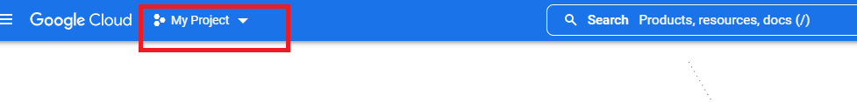
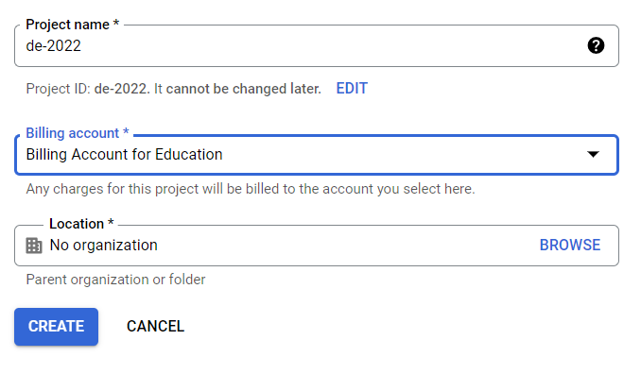
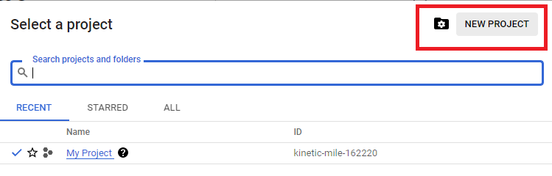
Create a GCP Project via Google Cloud Console
Go to the Google Cloud Console (https://console.cloud.google.com/welcome ) and select your project.
If there is no project, you must create one. Your project name may or may not be DE2022.
1
3
2

Slide 22
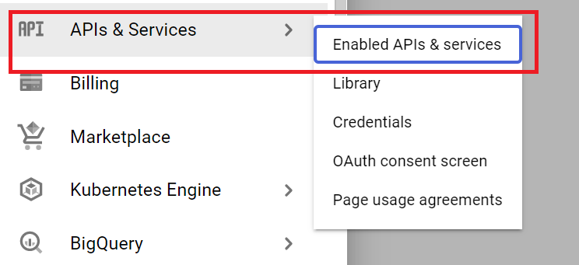
Enable Compute Engine API
Try to access https://console.cloud.google.com/compute/
You will be asked to enable API
You can also use API & Services

Slide 23
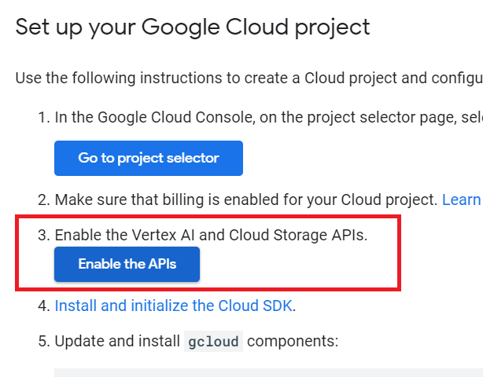
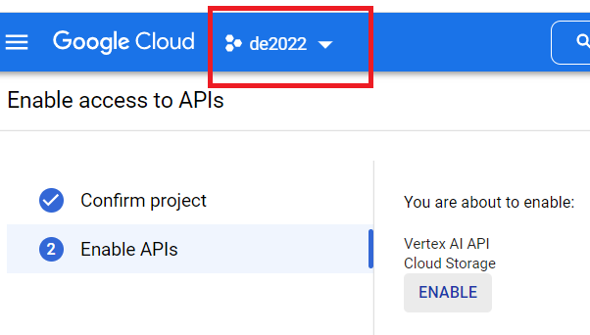
Enable Vertex-AI API and Storage API
Go to the page https://cloud.google.com/vertex-ai/docs/pipelines/configure-project
and click on “Enable the APIs”
Select your GCP project

Slide 24
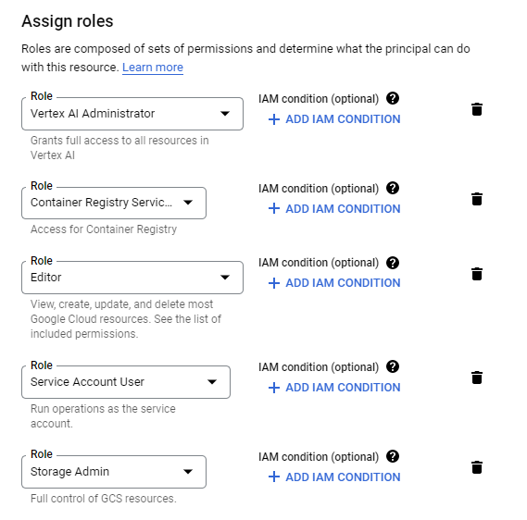
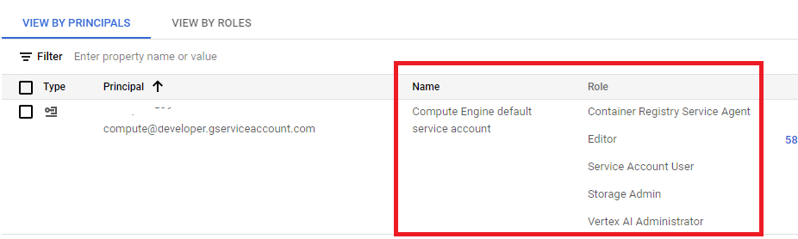
Configuring the Default Service Account
Add the following roles to the default developer service account (via IAM and Admin => IAM)
Container Registry Service Agent
Editor
Service Account User
Storage Admin
Vertex AI Administrator

Slide 25
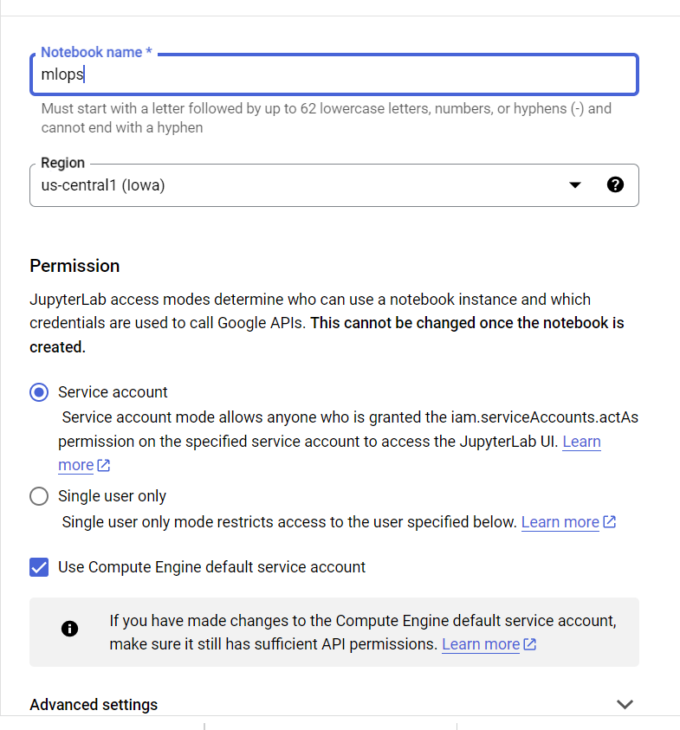
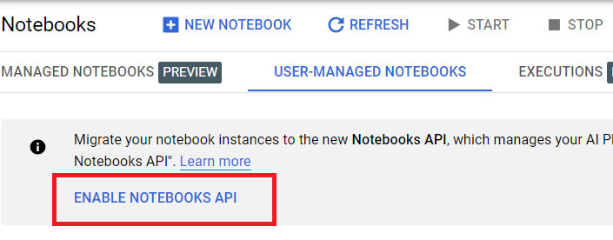
Building Vertex AI Pipelines
We will use the notebook environment provided by Vertex AI as the dev and experimentation environment.
Go to https://console.cloud.google.com/vertex-ai/workbench and enable Notebooks API.
Then, create a Notebook

Slide 26
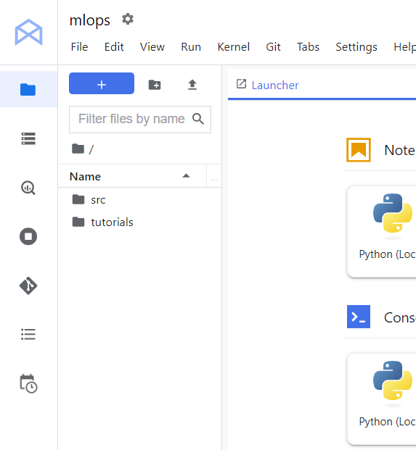
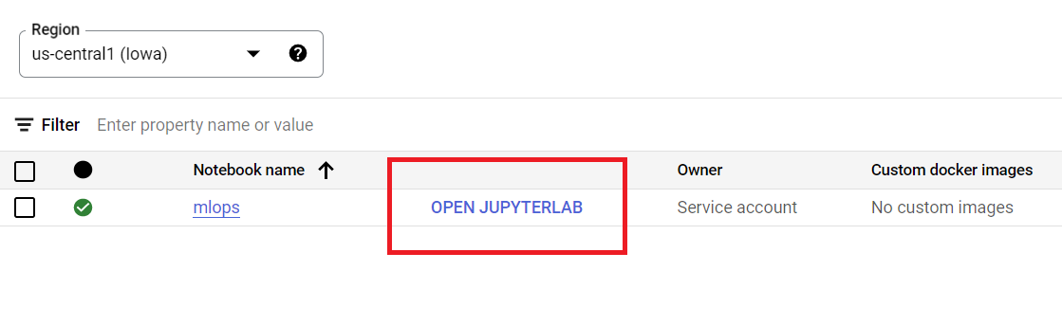
Building Vertex AI Pipelines (Cont’d)
Open Notebook

Slide 27
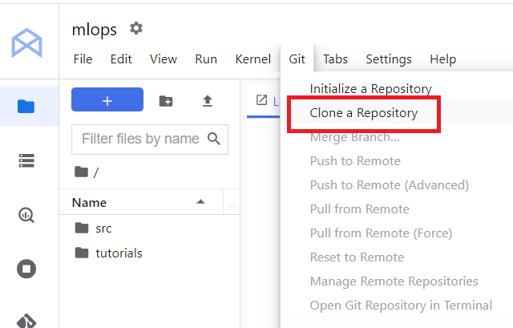
Building Vertex AI Pipelines (Cont’d)
We can clone our GitHub repository at Jupyter Lab environment.
https://github.com/IndikaKuma/MLOpsGCP.git

Slide 28
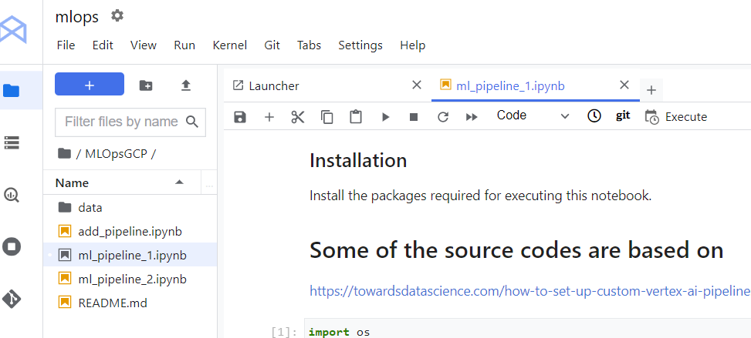
Building Vertex AI Pipelines (Cont’d)
Notebook for the pipeline development is ml_pipeline_1.ipynb
The pipeline uses Google Storage buckets to store data (training data) and models.

Slide 29
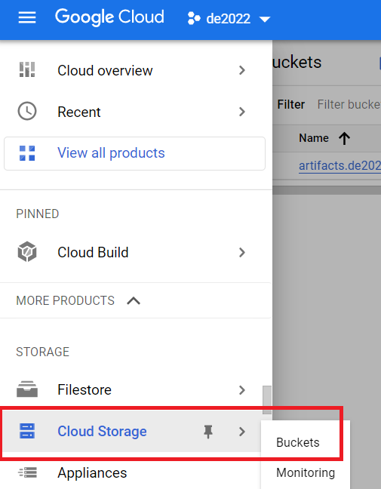
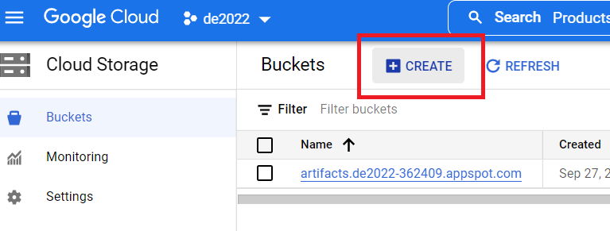
Creating and Using Google Cloud Storage Buckets

Slide 30
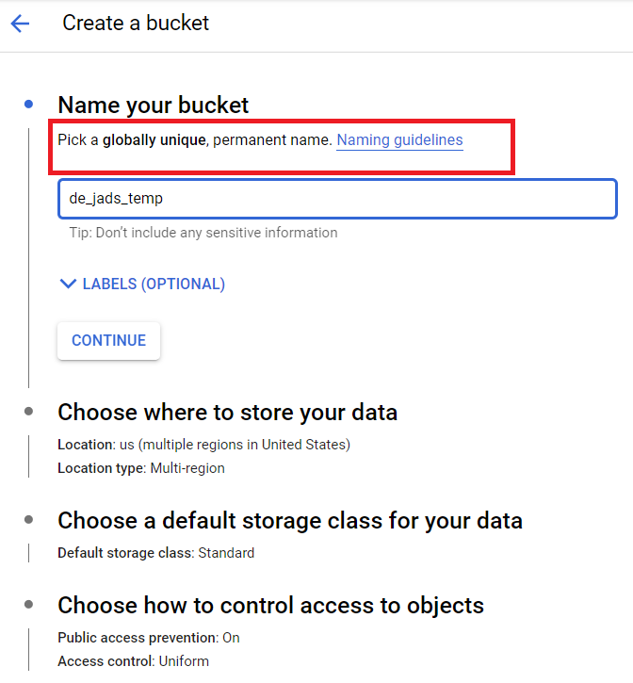
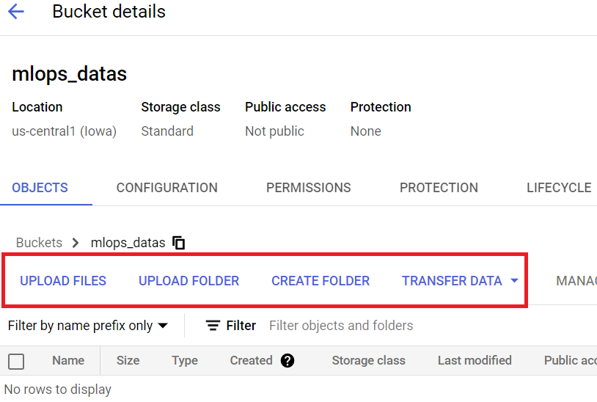
Creating and Using Google Cloud Storage Buckets (Cont’d)
Create three buckets: e.g., mlops_temp, mlops_models, and mlops_datas. Note you will not be able to use these same names (globally unique names). You can simply append your name to these names.
Use a specific region (the same for all buckets)

Slide 31
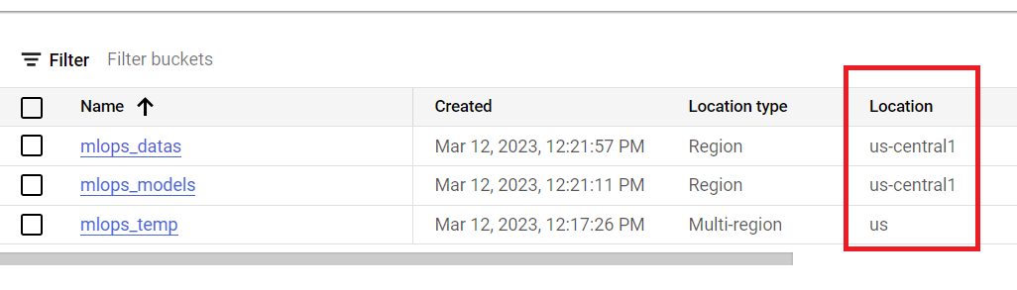
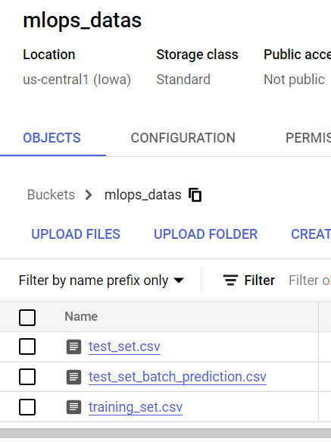
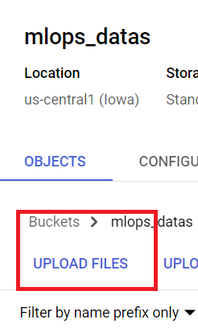
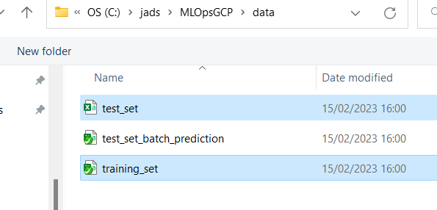
Creating and Using Google Cloud Storage Buckets (Cont’d)
Upload the training and test data to the data bucket

Slide 32
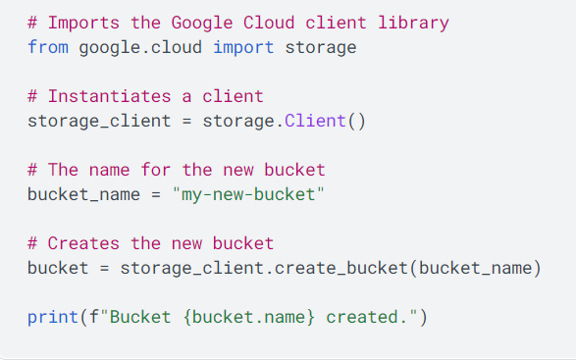
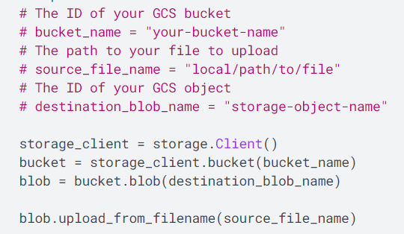
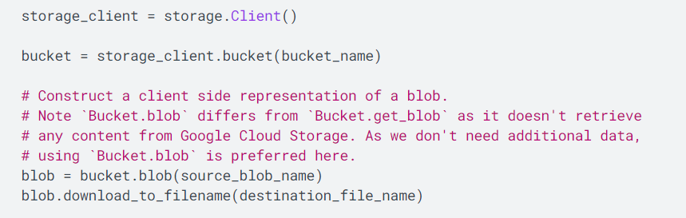
Creating and Using Google Cloud Storage Buckets (Cont’d)
Upload File
Create bucket
Download File

Slide 33
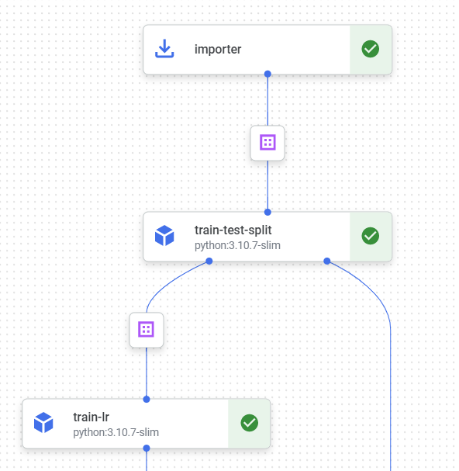
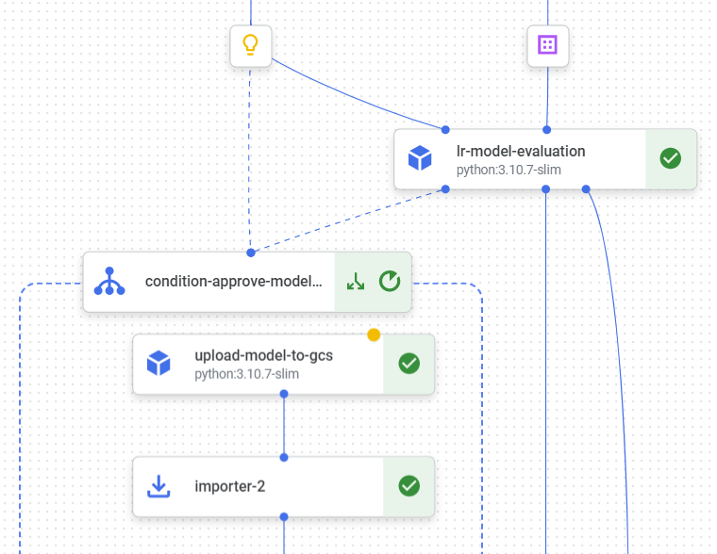
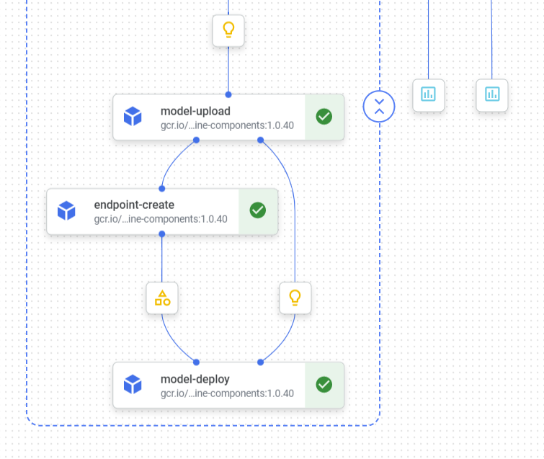
Back to the Pipeline
Let’s open ml_pipeline_1.ipynb and then run!

Slide 34
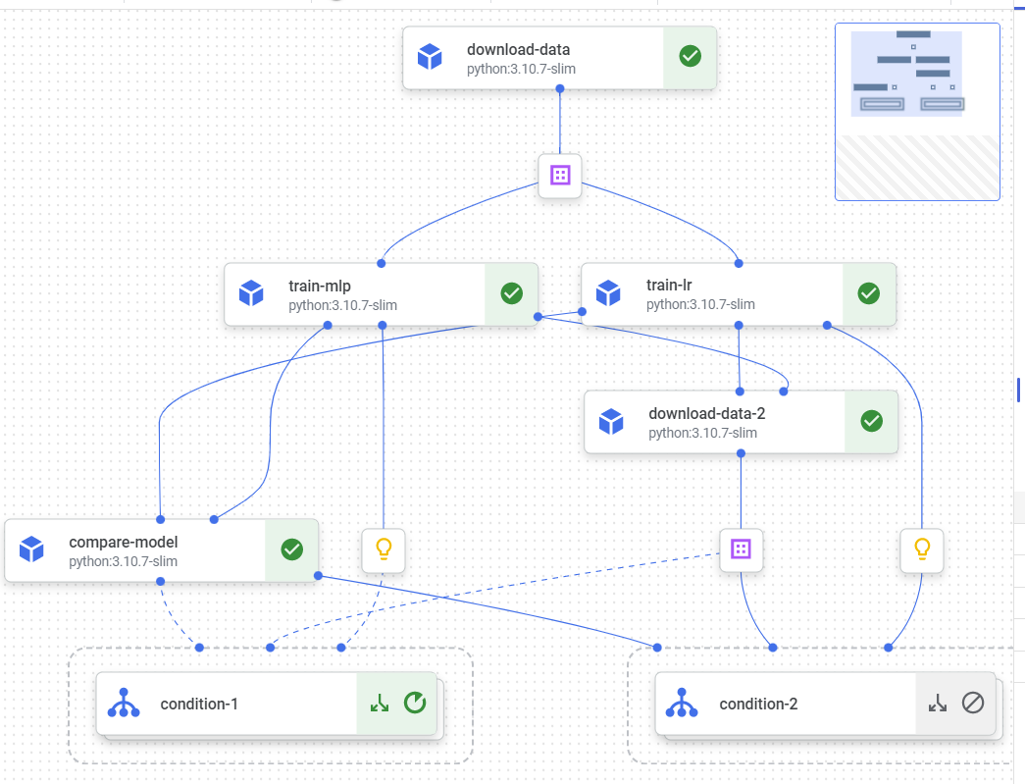
Another Example
See ml_pipeline_2.ipynb

Slide 35
Part 2: CI-CD for Model Deployment

Slide 36
Google Cloud Build
A serverless CI/CD platform from Google
It can import source code from a variety of repositories or cloud storage spaces, execute a build (of source code) to given specifications, produce artifacts such as Docker containers or Java binary files, and deploy artifacts across hybrid and multi-cloud environments that include VMs, serverless, and Kubernetes.
We need to write a build configuration file to provide tasks to be executed by Cloud Build.
e.g., fetch dependencies, run unit tests, run static analysis of code, and run integration tests, and create artifacts with build tools such as Docker and maven.

Slide 37
Structure of a Cloud Build CI-CD Pipeline
CI-CD pipelines are generally workflows (not only in Cloud Build but also in other tools such as Jenkins).
The pipeline consists of a set steps:
Each step specifies an action that we want Cloud Build to perform.
Each step run in a Docker container.
We can use any publicly available Docker images to execute our build tasks.
See https://cloud.google.com/build/docs/cloud-builders
We can write our own build steps (custom build tasks).
We simply need to package the task implementation into a Docker image.
Complete guide for the pipeline configuration https://cloud.google.com/build/docs/build-config-file-schema#json
We can use YAML or JSON for writing the pipeline configuration.

Slide 38
Key Elements of Build Configuration
{ "steps": [ { "name": "gcr.io/cloud-builders/kubectl", "args": [ "set", "image", "deployment/mydepl", "my-image=gcr.io/my-project/myimage" ], "env": [ "CLOUDSDK_COMPUTE_ZONE=us-east4-b", "CLOUDSDK_CONTAINER_CLUSTER=my-cluster" ] }, { "name": "gcr.io/cloud-builders/docker", "args": [ "build", "-t", "gcr.io/my-project-id/myimage", "." ] }, { "name": "gcr.io/cloud-builders/go", "args": [ "install", "." ], "env": [ "PROJECT_ROOT=hello" ], "dir": "mydir/examples" } ] }
A pipeline with three steps. Each step uses a container image from a container image registry (Google Container Registry (gcr.io)). Each such image includes a tool (e.g., docker CLI tool, Kubernetes cluster management tool (kubectl))
name - specify a cloud builder, which is a container image running common tools.
args - a list of arguments to be passed to the builder tool referenced by the name field. We can use them to invoke any command supported by the tool.
env - a list of environment variables to be used when running the step
dir - set a working directory to use when running the step's container . /workspace/<dir>. For example, /workspace/mydir/examples

Slide 39
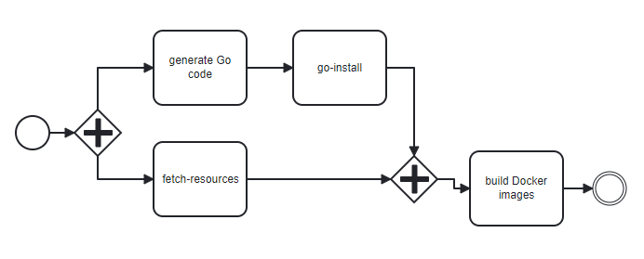
Key Elements of Build Configuration (Cont’d)
{ "steps": [ { "name": "gcr.io/cloud-builders/go", "args": [ "generate" ] }, { "name": "gcr.io/cloud-builders/go", "args": [ "install", "mytarget" ], "id": "go-install" }, { "name": "gcr.io/cloud-builders/gsutil", "args": [ "cp", "-r", "./somefiles", "gs://my-resource-bucket/somefiles" ], "waitFor": [ "-" ], "id": "fetch-resources" }, { "name": "gcr.io/cloud-builders/docker", "args": [ "build", "-t", "gcr.io/$PROJECT_ID/mytarget", "." ], "waitFor": [ "go-install", "fetch-resources" ] } ] }
Configuring the order of build steps
Use the waitFor field in a build step to specify which steps must run before the build step is run. If no values are provided for waitFor, the build step waits for all prior build steps in the build request to complete successfully before running.
To run a build step immediately at build time, use - in the waitFor field.
In this example, first, fetch-resources step uses gsutil to copy the local resources from Cloud Storage (waitFor -). Concurrently, go generate and installs the source code. Then, the docker build step builds the image after all other steps are complete (waitFor go-install and fetch-resources).

Slide 40
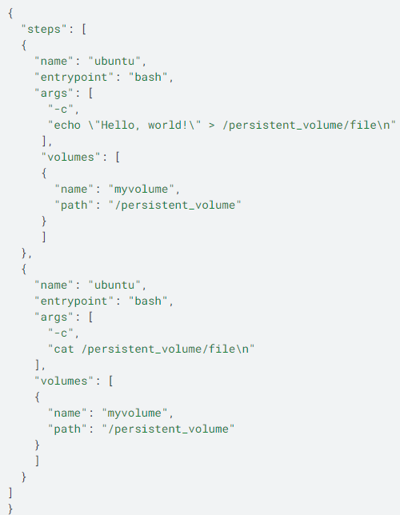
Key Elements of Build Configuration (Cont’d)
Passing data between build steps
To share/persist the data across build steps, Cloud Build provides volumes (read-write file paths). "/workspace" is the default volume. But we can also define our own custom volumes.
In this example, the first build step saves the text “Hello word!” into the /persistent_volume/file. The second step reads that text from the /persistent_volume/file.
Note, we can always use the default volume /workspace/ without defining a new volume. For example, /workspace/file

Slide 41
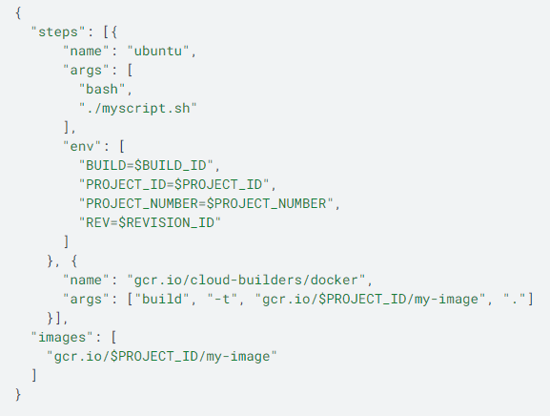
Key Elements of Build Configuration (Cont’d)
Substituting variable values
We can use substitutions in our build config file to substitute specific variables at build time.
Cloud Build provides built-in substitutions, or we can also define your own substitutions.
https://cloud.google.com/build/docs/configuring-builds/substitute-variable-values
here, the values for the variable such as $PROJECT_ID will be substituted by the cloud builder automatically.

Slide 42
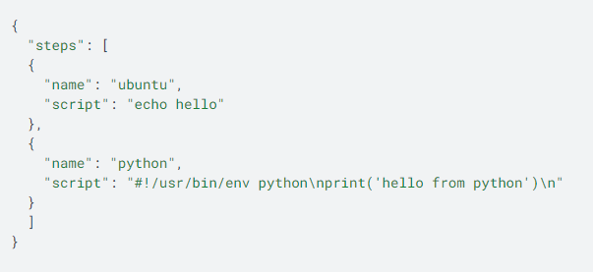
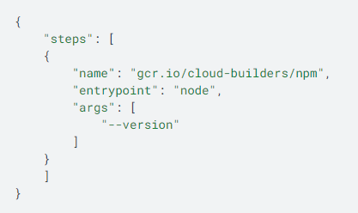
Key Elements of Build Configuration (Cont’d)
We can use the script field to specify a shell script (.sh file) to execute in the step.
We can use the entrypoint to specify an entrypoint (if the builder tool provides multiple entrypoints and we do not want to use the default)
CMD and ENTRYPOINT both specify programs that execute when the container starts running
CMD instructions can be overwritten by using the command line arguments with the docker run command.
ENTRYPOINT instructions cannot be overwritten - command line arguments will be simply appended and treat those as arguments of the command.
https://www.bmc.com/blogs/docker-cmd-vs-entrypoint/
ENTRYPOINT ["python3"] CMD ["app.py"]

Slide 43
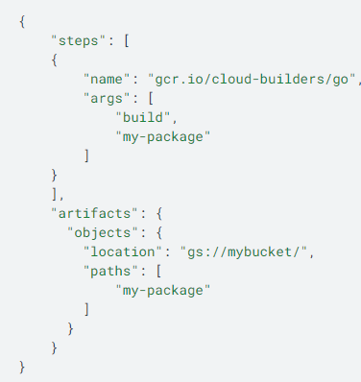
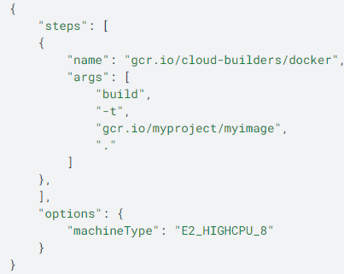
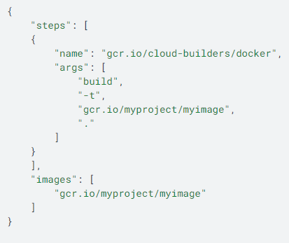
Key Elements of Build Configuration (Cont’d)
The images field specifies one or more Docker images to be pushed by Cloud Build to Container Registry.
The options field specifies the optional arguments for a build, for example, the machine type of the VM that runs the build, a custom disk size for the build, storing build logs, etc.
The artifacts field specifies one or more non-container artifacts to be stored in Cloud Storage.

Slide 44
Let’s Try to Create a Pipeline to Deploy Model API and UI

Slide 45
Cloud Build File
cloud_build_cloud_run_deployment.json file
Test Prediction API, and build and push its Docker image
Build and push Docker image of Prediction UI
Deploy the docker images to Cloud Run

Slide 46
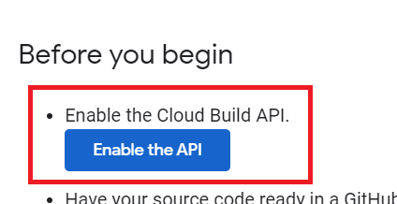
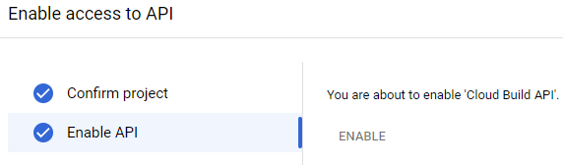

Create and Execute a Build Trigger at Cloud Build
Enable Cloud Build API
https://cloud.google.com/build/docs/automating-builds/build-repos-from-github
Go to Cloud Build and Consider Settings

Slide 47

Create and Execute a Build Trigger at Cloud Build
Create and Run Trigger
https://console.cloud.google.com/cloud-build/triggers
Follow the wizard

Slide 48


Create and Execute a Build Trigger at Cloud Build (Cont’d)

Slide 49


Create and Execute a Build Trigger at Cloud Build (Cont’d)
Use your model repo bucket name

Slide 50


Create and Execute a Build Trigger at Cloud Build (Cont’d)
This is for prediction-ui-embedded
Use your model repo bucket name

Slide 51


Create and Execute a Build Trigger at Cloud Build (Cont’d)

Slide 52


Create and Execute a Build Trigger at Cloud Build (Cont’d)
Check Docker Images in Container Registry

Slide 53



Check Services in Cloud Run
Test the Prediction API and UI
[ { "ntp": 1, "pgc": 126, "dbp": 60, "tsft": 0, "si": 0, "bmi": 30.1, "dpf": 0.349, "age": 47 } ]
https://prediction-ui-73mskbvyxa-uc.a.run.app/checkdiabetes

Slide 54


Check Services in Cloud Run: Prediction-UI-Embedded
Test the Prediction UI
[ { "ntp": 1, "pgc": 126, "dbp": 60, "tsft": 0, "si": 0, "bmi": 30.1, "dpf": 0.349, "age": 47 } ]
https://prediction-ui-embedded-73mskbvyxa-uc.a.run.app/checkdiabetes

Slide 55
Part 3: Event-Driven Triggering of Training and Model Deployment

Slide 56
Automated (Continuous) Training and Model Deployment
Trigger Types
On demand: Ad-hoc the manual execution of the pipeline.
Scheduled
The models are retrained periodically, according a schedule (e.g., daily, weekly, or monthly)
Event-driven
An event indicates a change in the MLOps environment. e.g., updating the source code in the GitHub repository and adding a new feature set to the feature store.
Metric-based
Some metrics are monitored and used to determine if re-retraining is necessary. e.g., model performance metrics and data quality metrics

Slide 57
Use Case Updated
Add/update training set
adadata
adamodels
Upload the model
Triggers
Triggers
Serverless Function 1
Vertex AI
Serverless Function 2
Train
Publish a message
Deploy Model API and UI
Cloud Run
Cloud Build CI-CD
Triggers
PubSub

Slide 58
What is Google Cloud Functions?
Cloud Functions is a lightweight compute solution for developers to create single-purpose, stand-alone functions that respond to Cloud events without the need to manage a server or runtime environment.
https://cloud.google.com/functions/docs
There are two types of cloud functions:
HTTP functions, which we can invoke from standard HTTP requests.
Even-driven background functions, which we can use to handle events from the cloud infrastructure.

Slide 59

Capabilities of 2nd Generation Google Cloud Functions
Longer request processing
Larger instances
Concurrency
up to 1,000 concurrent requests per function instance
Triggers from over 90 event sources.

Slide 60

Event-Driven Functions
Functions that are triggered by events from the Cloud infrastructure.
https://cloud.google.com/functions/docs/calling
HTTP Triggers
Cloud Pub/Sub Triggers
Cloud Storage Triggers
Direct Triggers
Cloud Firestore
Analytics for Firebase
Firebase Realtime Database
Firebase Authentication
Eventarc Triggers
A use case of simulation using virtual devices
ref: https://laptrinhx.com/signify-chooses-google-cloud-iot-core-to-power-philips-hue-smart-lighting-2104641386/
Notes:
Cloud Firestore is a cloud-hosted, NoSQL database.

Slide 61
What is Eventarc?
Eventarc is a new product from Google to help building event-driven architectures.
Events are routed from an event producer/provider(the source) to interested event consumers (the destinations).
Producers and consumers can be microservices.
Google Pub/Sub is used for routing events to a specific consumer.
2nd Generation Cloud Functions always use Eventarc.
Events use CloudEvents format
CloudEvents is a specification for describing event data in common formats to provide interoperability across services, platforms and systems.
https://github.com/cloudevents/spec
Support many event providers, destinations, and event types
https://cloud.google.com/eventarc/docs/event-providers-targets
https://cloud.google.com/eventarc/docs/event-types

Slide 62

What is Eventarc? (Cont’d)

Slide 63

What is Google Pub/sub?
Google Pub/Sub is a message broker, similar to Kafka.
Topic. A named resource to which messages are sent by publishers.
Subscription. A named resource representing the stream of messages from a single, specific topic, to be delivered to the subscribing application.
Publisher. An application that creates and sends messages to a topic(s).
Subscriber. An application with a subscription to a topic(s) to receive messages from it.
Pub/Sub message flow
https://cloud.google.com/pubsub/docs/overview

Slide 64

Google Pub/sub (Cont’d)
Implementing point-to-point and publish-subscribe messaging channels with Google Pub-Sub.
https://www.enterpriseintegrationpatterns.com/patterns/messaging/PublishSubscribeChannel.html

Slide 65


Google Pub/sub (Cont’d)
Pull vs Push models
https://cloud.google.com/run/docs/triggering/pubsub-push
https://cloud.google.com/pubsub/docs/push?hl=IT
https://cloud.google.com/pubsub/docs/subscriber#create
A subscriber receives messages either by Pub/Sub pushing them to the subscriber's chosen endpoint, or by the subscriber pulling them from the topic.
Pull (Polling Consumer Pattern)
Push (Event-Driven Consumer Pattern)
See https://medium.com/google-cloud/secure-pubsub-push-with-cloud-endpoints-6a1adc36db9f for push-based model for RESTful microservice execution
Notes:
Push Model Needs the service endpoint with :
An HTTPS server with non-self-signed certificate accessible on the public web. The receiving endpoint may be decoupled from the Pub/Sub subscription, so that messages from multiple subscriptions may be sent to a single endpoint.
We can build HTTPS Flask endpoints. However, we do not have non-self-signed certificates.
See https://cloud.google.com/load-balancing/docs/ssl-certificates/self-managed-certs
See https://stackoverflow.com/questions/29458548/can-you-add-https-functionality-to-a-python-flask-web-server

Slide 66
Let’s Cloud Functions and Cloud Events to Triger Pipelines …

Slide 67


Configuring APIs and IAM for Cloud Functions
Go to APIs & Services and enable Cloud Functions, EventArc, EventArch Publishing, Artifact Registry, Cloud Run, and Pub/Sub APIs
Search APIs and enable them

Slide 68


Configuring APIs and IAM for Cloud Functions
Configure GCP Storage and EventArc Permissions
If you have not configured the permissions correctly, you may get errors like the following.
….@appspot.gserviceaccount.com does not have storage.buckets.get access to the Google Cloud Storage bucket.
Solution:
Add Storage Admin, Pub/Sub Admin, EventArc Admin Roles

Slide 69


Configuring APIs and IAM for Cloud Functions
Grant the pubsub.publisher role to the Cloud Storage service account:
Find the storage service account name
Add a new Grant Access (IAM and Admin)

Slide 70

Installing Google Cloud SDK
Install and initialize the Cloud SDK
Install this in your Laptop and/or Google VM (the development environment)
Please follow the instructions at https://cloud.google.com/sdk/docs/install
Select the instructions for your operating system, e.g., MaC or Windows
To deploy the cloud function from our laptop, we need GCloud SDK

Slide 71
Installing Google Cloud SDK
Prepare your development environment
See https://cloud.google.com/python/docs/setup
I am using PyCharm
For Windows users, when you run gcloud commands, you may get an error
Open Powershell as admin and change the execution policy into ByPass
Set-ExecutionPolicy -ExecutionPolicy ByPass
https://lazyadmin.nl/powershell/running-scripts-is-disabled-on-this-system/
Notes:
pip install --no-cache-dir -r requirements.txt

Slide 72
Let’s Check the Source Code of the Cloud functions
There are two cloud functions:
Trigger the Vertex AI Pipeline
Source code at ./trigger_vertext_ai
Trigger the CI-CD build pipeline for model deployment (prediction API and UI deployment)
Source code at ./trigger_cicd_cloud_run

Slide 73
Let’s Check Vertex AI Pipeline and its Parameters
We are going to use the version of the first Vertex AI pipeline we created.
The deployment into the Vertex AI’s model registry was removed
The new pipeline is ml_pipeline_3.ipynb and its definition is diabetes_predictor_training_pipeline_3.json (at /pipeline_conf)
parameters.json at /pipeline_conf includes the pipeline job parameters.

Slide 74

Triggering Vertex AI Training Pipelines
Create a new storage buckets
mlops_confs – to store the Vertex pipeline configuration file
Not the region of a cloud function and the buckets (used by it) should be the same.

Slide 75

Triggering Vertex AI Training Pipelines (Cont’d)
Upload the two files at ./pipeline_conf to mlops_confs bucket
Carefully check and update parameters in parameters.json before uploading it

Slide 76
Triggering Vertex AI Training Pipelines (Cont’d)
Deploy the cloud function at ./trigger_vertext_ai
Set the project id
gcloud config set project $your_project_id
You may have to first run gcloud auth application-default login
This makes sure the default service account is used and authenticated to execute gcloud commands.
Run run the following command within the trigger_vertext_ai directory
gcloud functions deploy vertexai-pipeline-trigger --runtime python310 --region=us-central1 --gen2 --entry-point=trigger_vertexai_pipeline --trigger-event-filters="type=google.cloud.storage.object.v1.finalized" --trigger-event-filters="bucket=mlops_datas" --env-vars-file .env.yaml --allow-unauthenticated
Carefully check and update environment variables in .env.yaml
More on Deployment Command: https://cloud.google.com/sdk/gcloud/reference/app/deploy

Slide 77


Triggering CI-CD Pipelines
Go to the Cloud Build and create a trigger with Pub/Sub option.
Use model-update as the topic (I am using this topic in the function source code)

Slide 78
Triggering CI-CD Pipelines (Cont’d)
Deploy the cloud function at trigger_cicd_cloud_run
Reupload the training_set.csv at data to the mlops_datas bucket
This will create the model (the first cloud function) and upload it to the mlops_models, which triggers the second cloud function.
The second cloud function will publish a message to the model-update topic, which triggers the CI-CD build.
The prediction AI and UI will be deployed on Cloud Run.
gcloud functions deploy model-update-notifier --runtime python310 --region=us-central1 --gen2 --entry-point=notify_model_update --trigger-event-filters="type=google.cloud.storage.object.v1.finalized" --trigger-event-filters="bucket=mlops_models" --env-vars-file .env.yaml --allow-unauthenticated
Carefully check and update environment variables in .env.yaml
Check Vertex AI, Cloud Build, and Cloud Run

Slide 79




Check Cloud Functions, EventArc, and Pub/Sub

Slide 80
Recap
We did:
ML Pipelines
CI-CD Pipelines for deploying models
Automated Triggering of pipelines
We did not:
Model deployment strategies – shadow, canary, and blue-green
We can easily implement these with Kubernetes (GKE).
Model monitoring

Slide 81
References
Google Documentation

Slide 82
www.jads.nl

